Slide 1
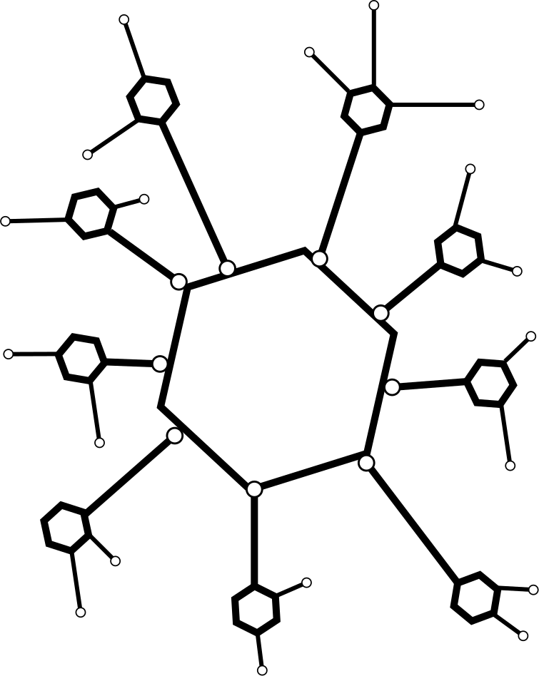
All about Small Scale LLM’s !
By Anustup Mukherjee

Slide 2


Machine Learning Engineer at Newton School, Ex- GSOC(Tensorflow), Samsung, Shell, IIT Patna, WRI, worked with 15 + startups round the globe in developing AI models from scratch, holding patents, research and publications in AI along with Indian young achievers award for contributions in AI development, Spoken at 60 + conferences, hackathons and webinars including HPAIR, MIT tech X , India Summit, Py Bangalore , Belgium Pycon.

Slide 3
Talk Contents
Understanding Basic Structure and How LLM’s Work
Architecture Review:
LLaMa 2
Zephyr
Mistral
What is Human Machine Intent Alignment and why is it important for Gen-AI applications
What is Domain Adaptive Learning
How does GPT deal with these?
Discussion on Approaches
Conclusion

Slide 4
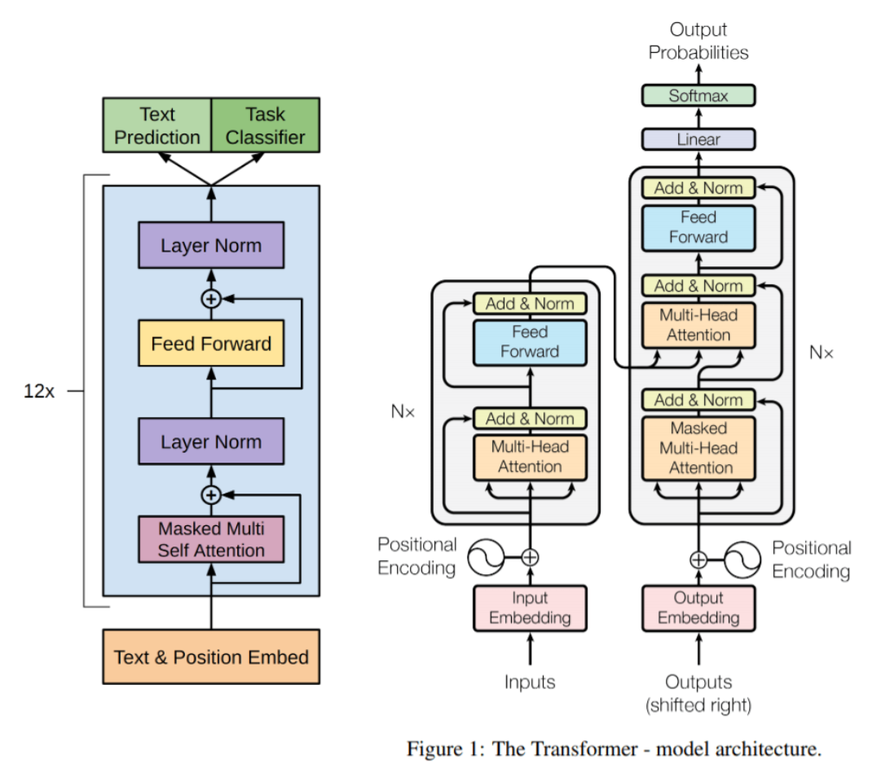
LLM in a Nut Shell
For Demo will be using : https://bbycroft.net/llm

Slide 5
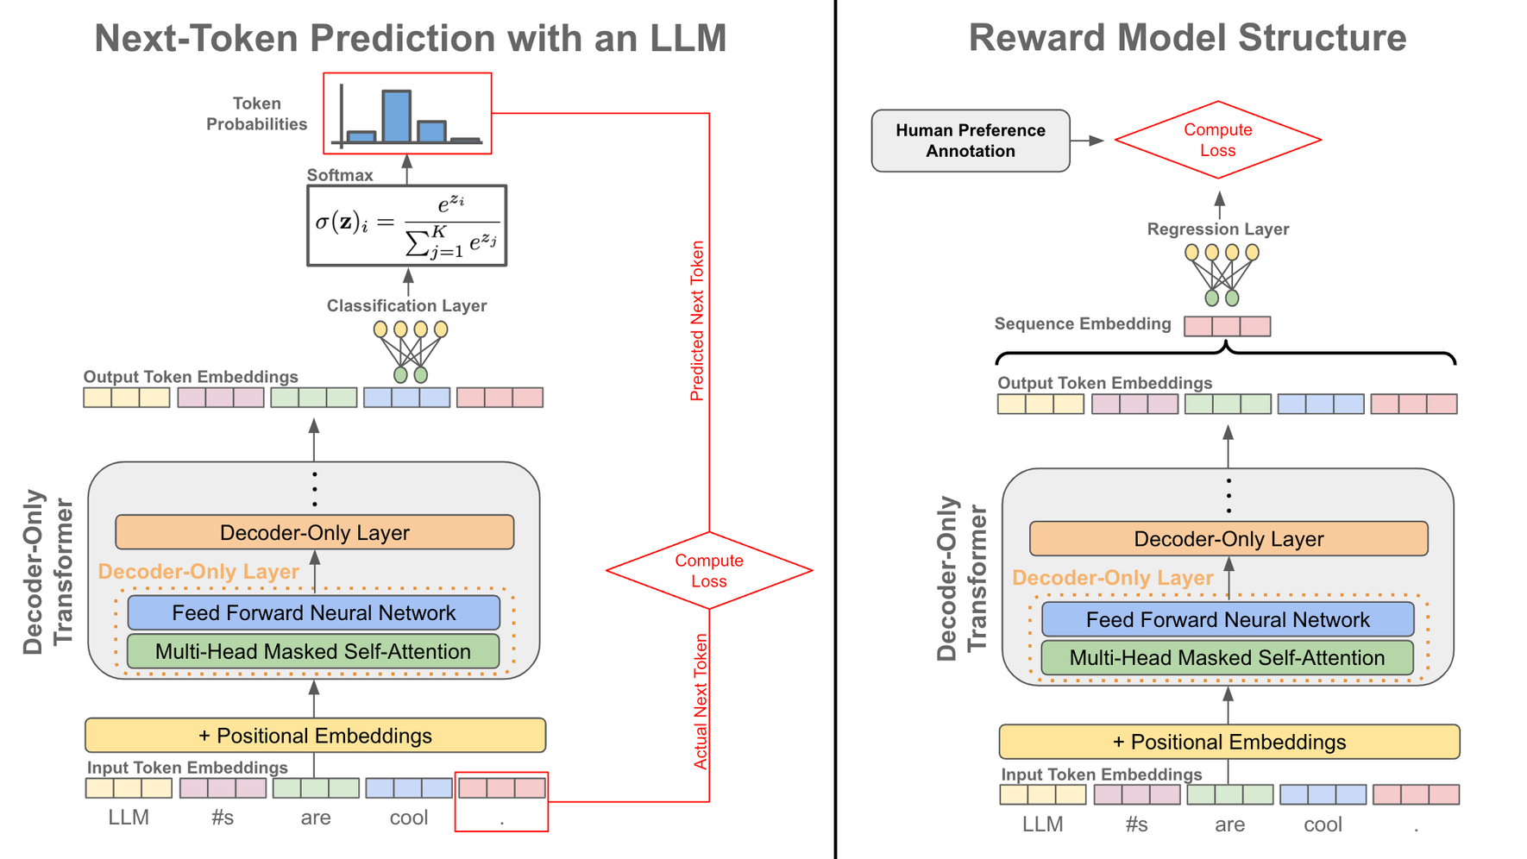
Architecture Review : LLaMa 2

Slide 6
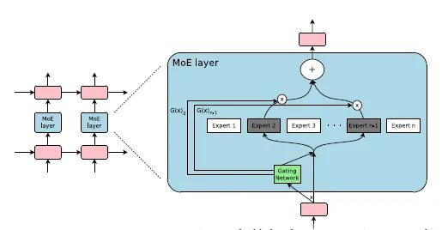
Architecture Review : Mistral

Slide 7
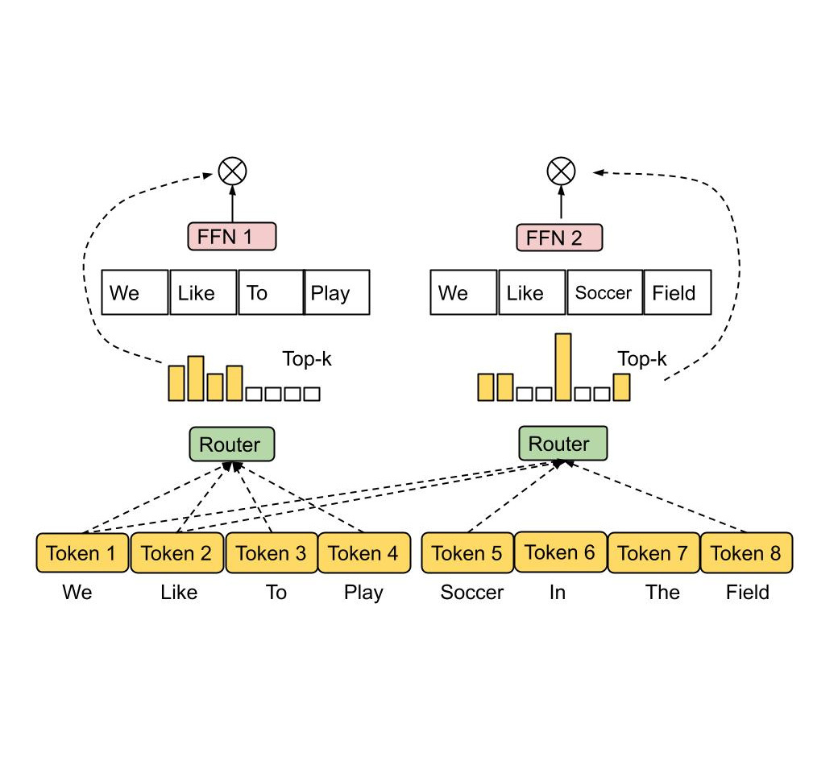
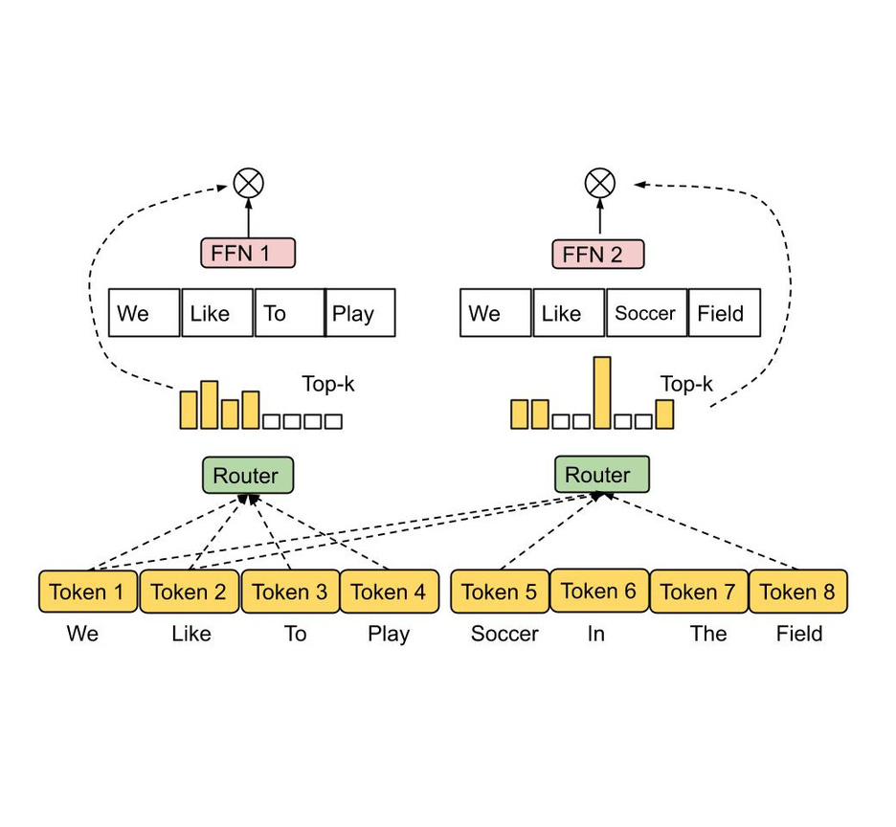
What is MOE

Slide 8
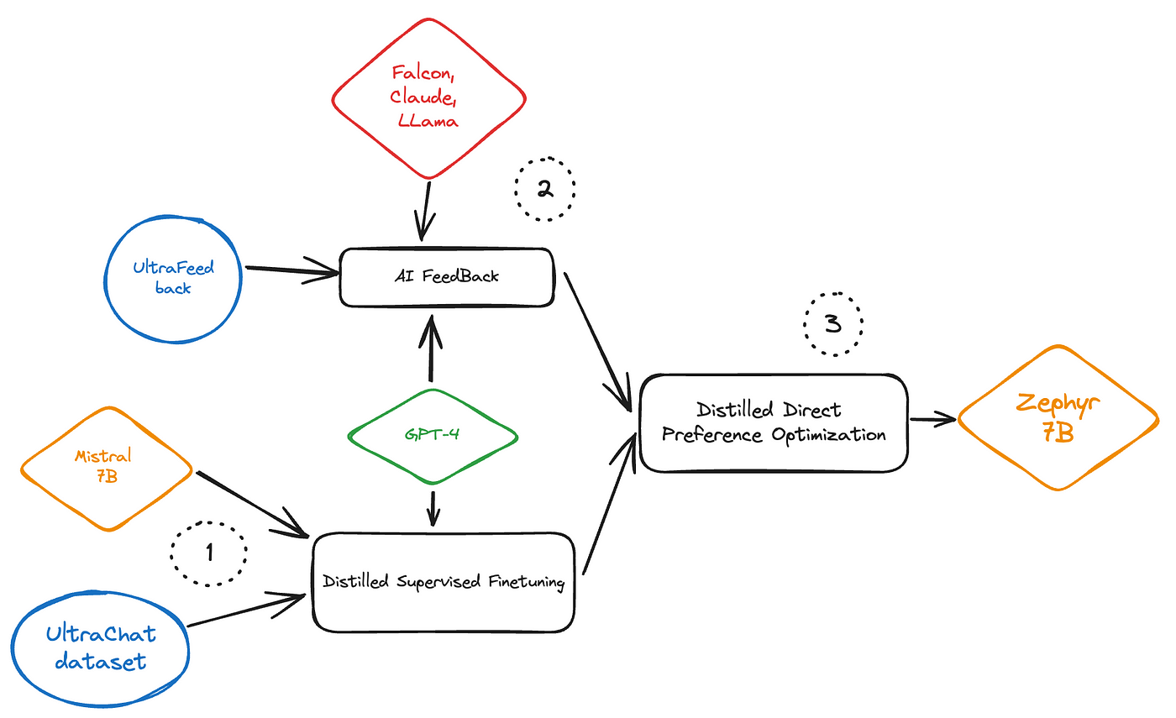
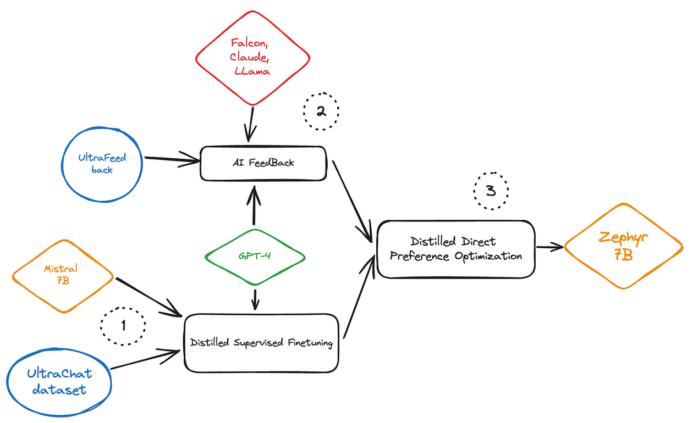
Architecture Review : Zephyr

Slide 9
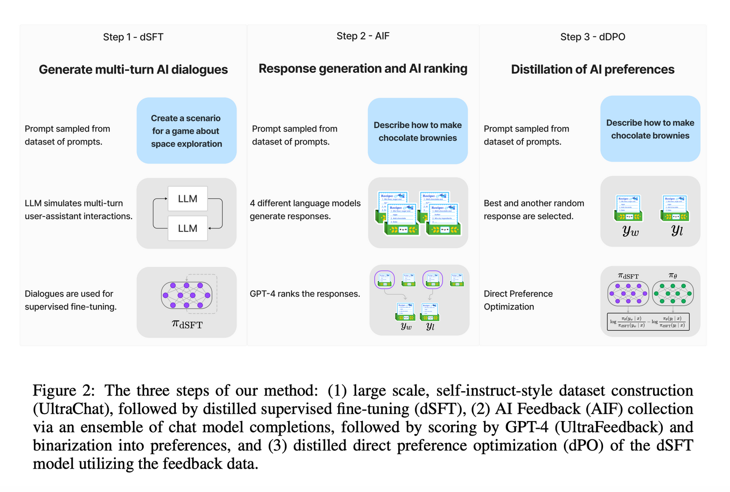
Human Machine Intent Alignment and What are the impacts in Gen -AI

Slide 10
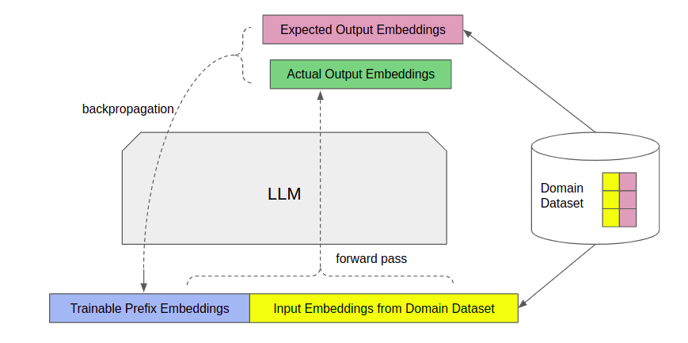
Domain Adaptive Learning

Slide 11
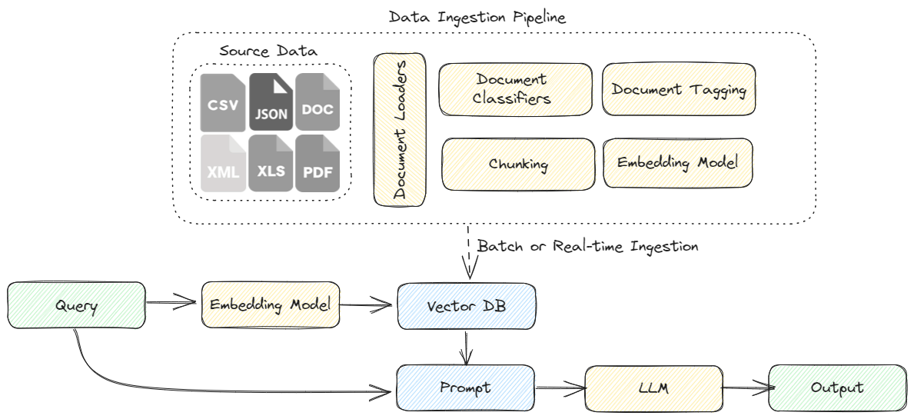

Slide 12
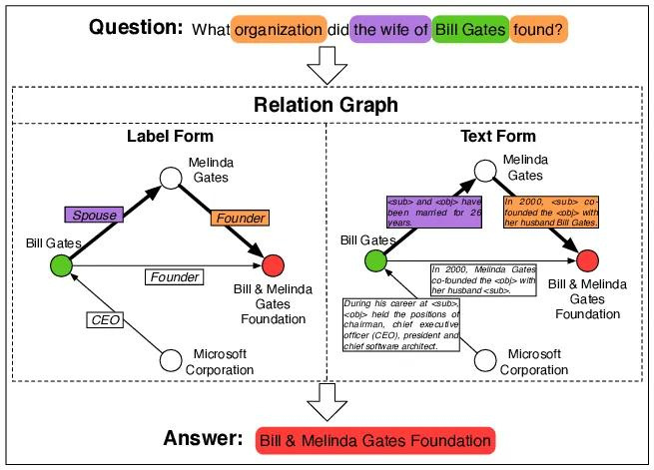

Slide 13
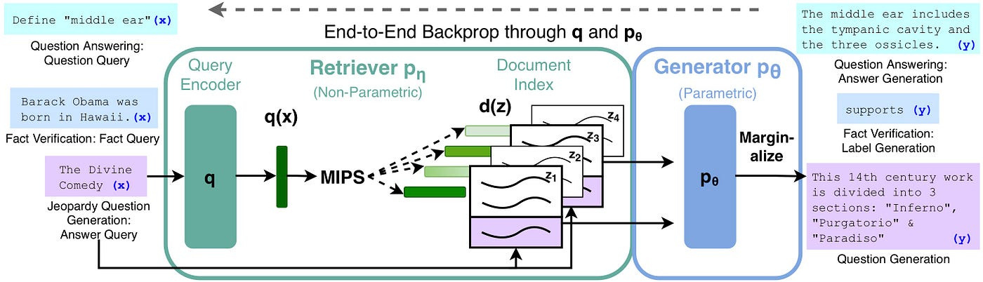

Slide 14

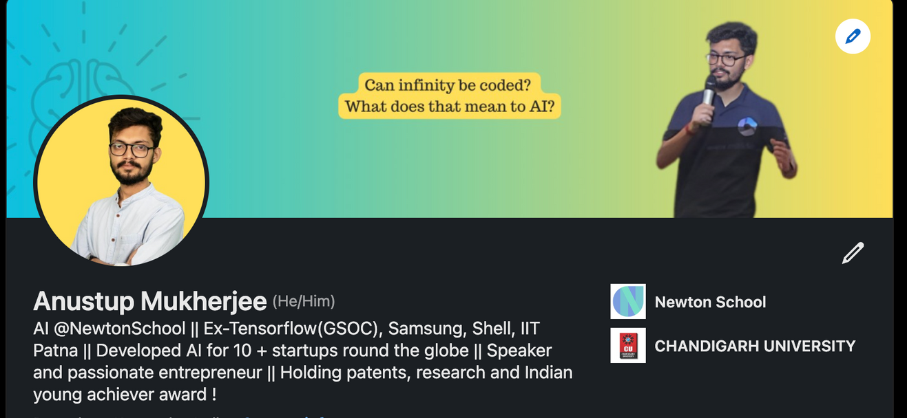
Thank you
Feel Free to Connect !

